Slide 1
Task– 4
Name : Atish GOUNDADKAR

Slide 2
Project objective
This case study aims to identify the customers to whom the bank can disburse the loan taking business type, business sector, business activity ,CBIL score of the customer . We need to create a model which indicate if a customer has ability towards paying their loans or not taking various features in consideration.

Slide 3
approach with SQL
Understanding the database and four tables in sqlite3 we have to connect with sqlite databse to collect the tables. After connecting with the sqlite3 database we have merged the four tables available in database with inner join and left join,so that we can join all the tables and create a dataset to run the model. Once the dataset was created we have removed the duplicate columns created while joining the tables. After data frame was ready we have used the Jupyter Python Notebook to load and understand the datasets for both Current Applications & Previous Applications. We have gone through the breadth & the depth of the attributes present in the datasets along with their definition to understand the data quality & its spread at a high level.

Slide 4
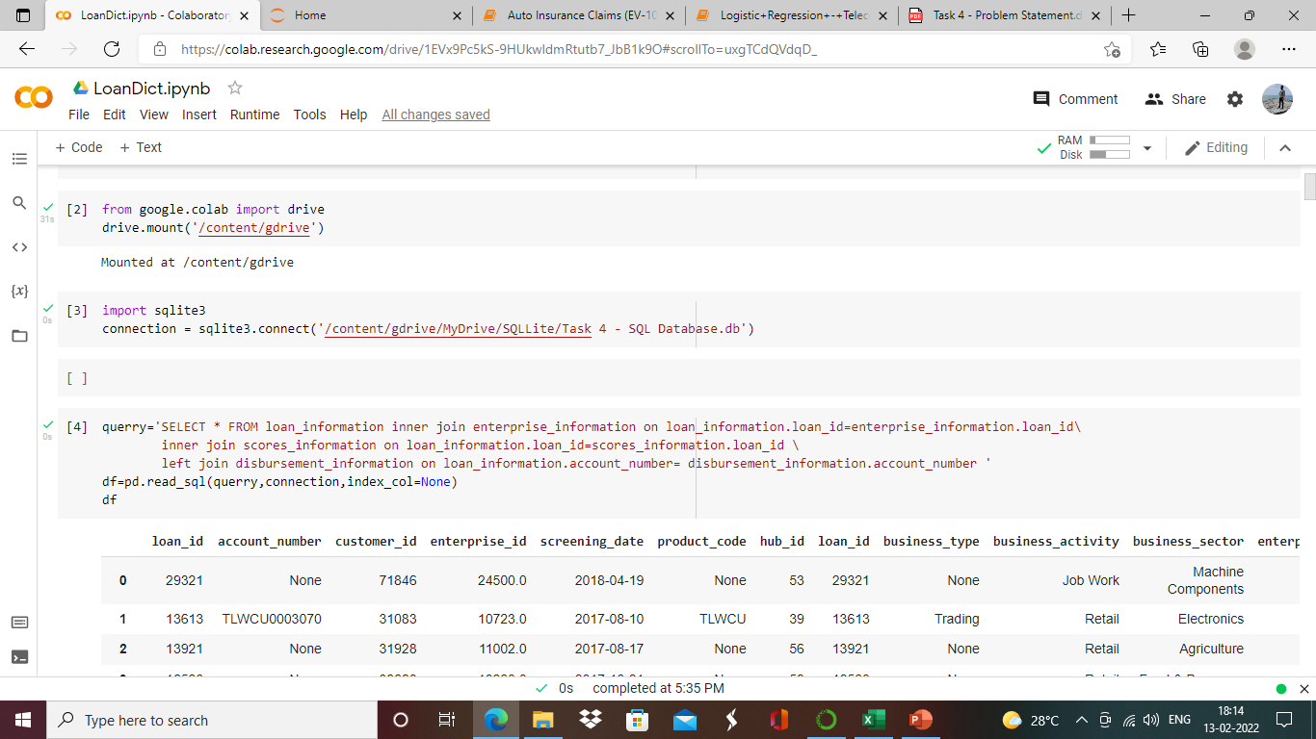
SQL query to connect with data

Slide 5
Cleaning the dataset
Data Preparation/Cleaning: After a clear understanding of the problem statement & the given datasets, we moved to the most critical & an essential part of this project i.e. Data Clearing & preparing the data for further analysis. In this process, we found quite a few irregularities in the data such as missing values in most of the attributes; outliers present in continuous type column. Target/Label attribute was not clear which we have infer from observations. Incorrect data format & invalid values/records. We have then performed all the necessary operations to clean the data as much as we could in order to make it ready for further analysis.

Slide 6
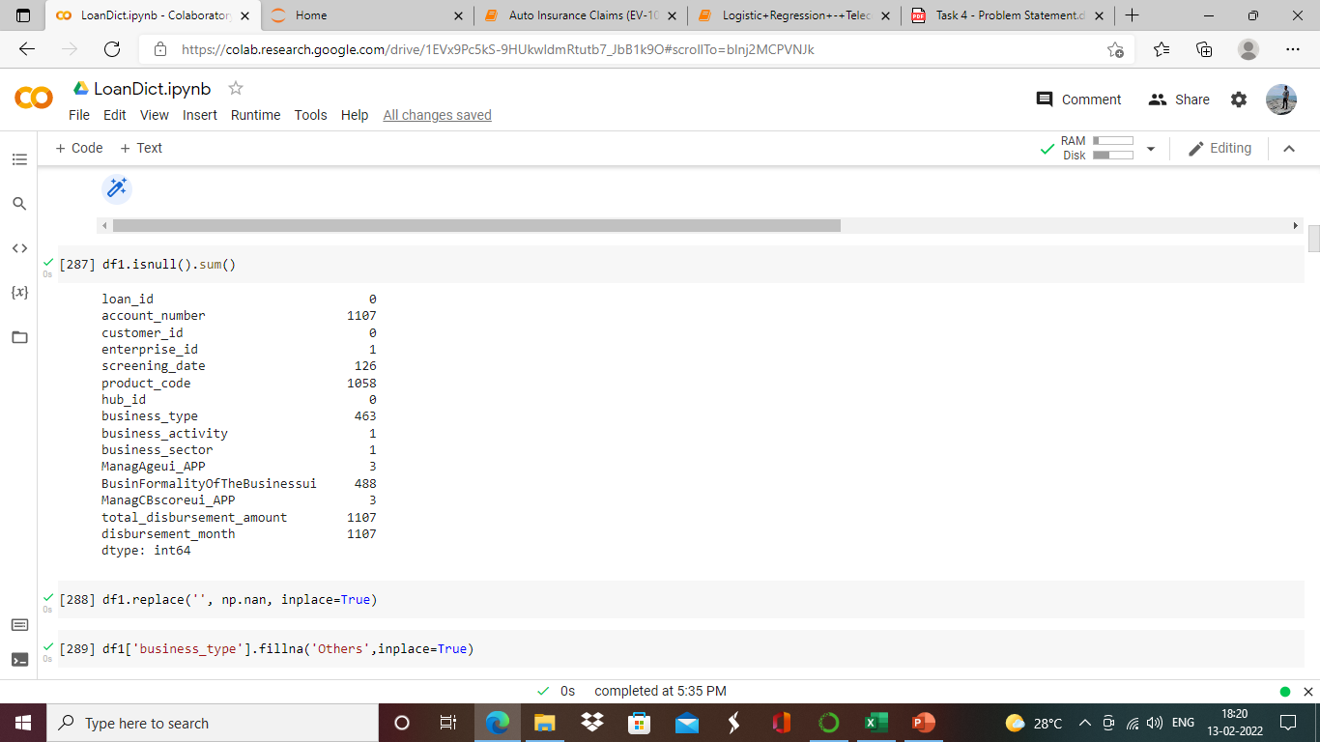
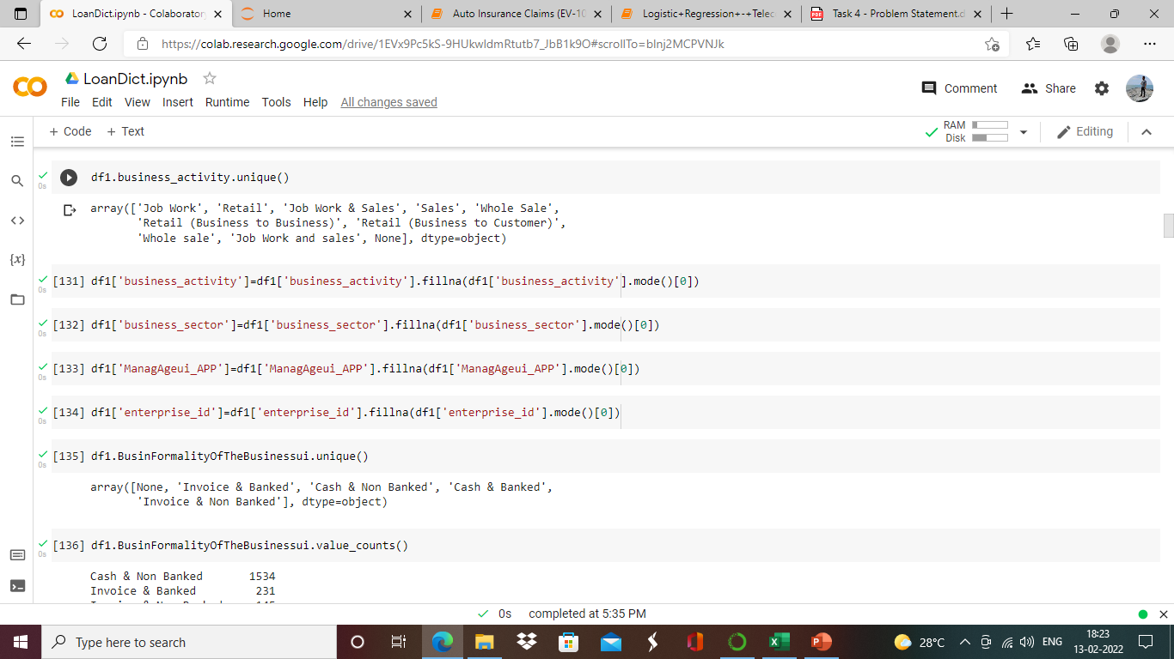
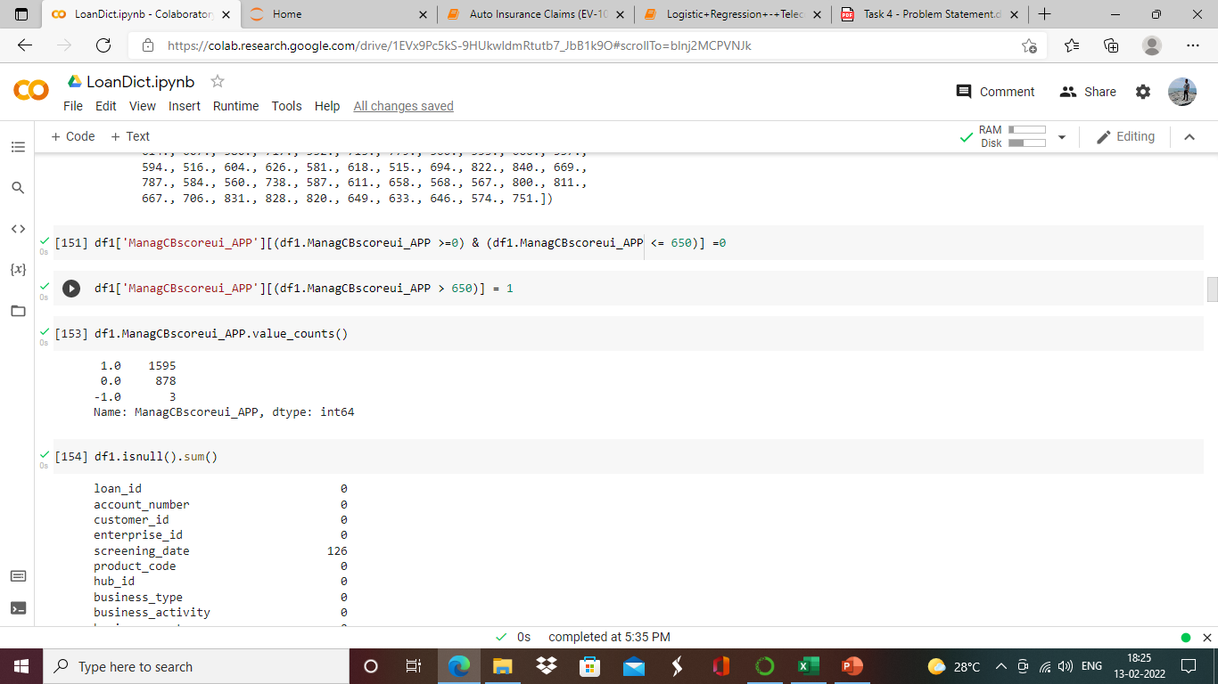
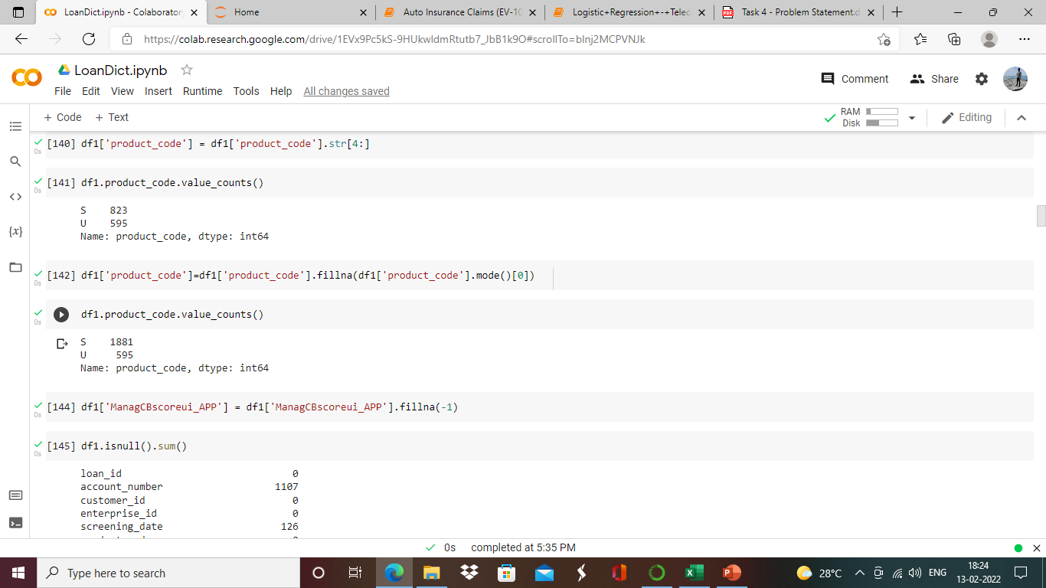
data cleaning PROCEDURE

Slide 7
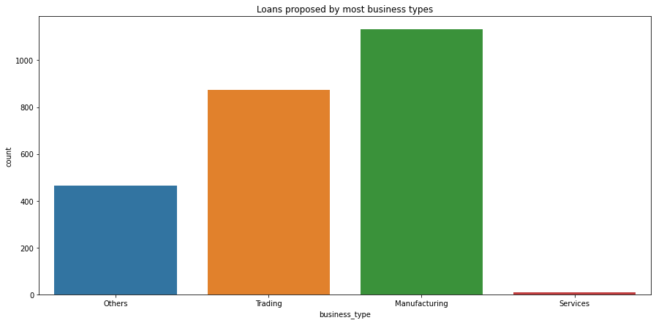
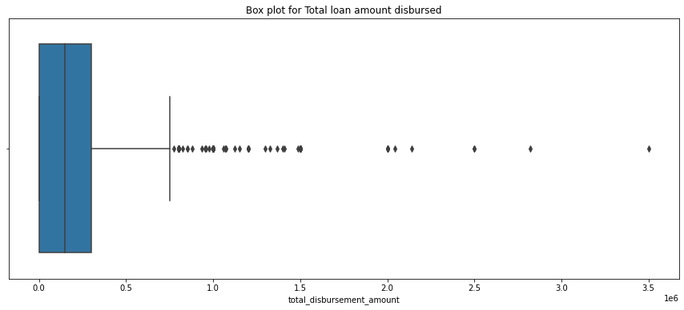
Data Analysis:
we performed various types of Univariate, Bivariate analysis by plotting appropriate graphs with respect to the Target variable. This helped us to draw relevant insights. As shown further. Few of the imp insights we have attached here

Slide 8
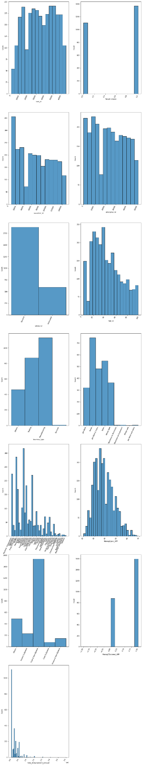
Histograms

Slide 9

Histogram-2

Slide 10

Histogram -3

Slide 11

Histogram - 4

Slide 12
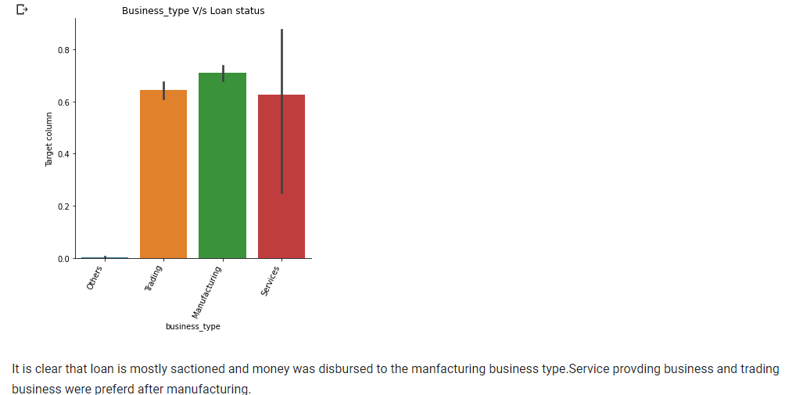

Slide 13
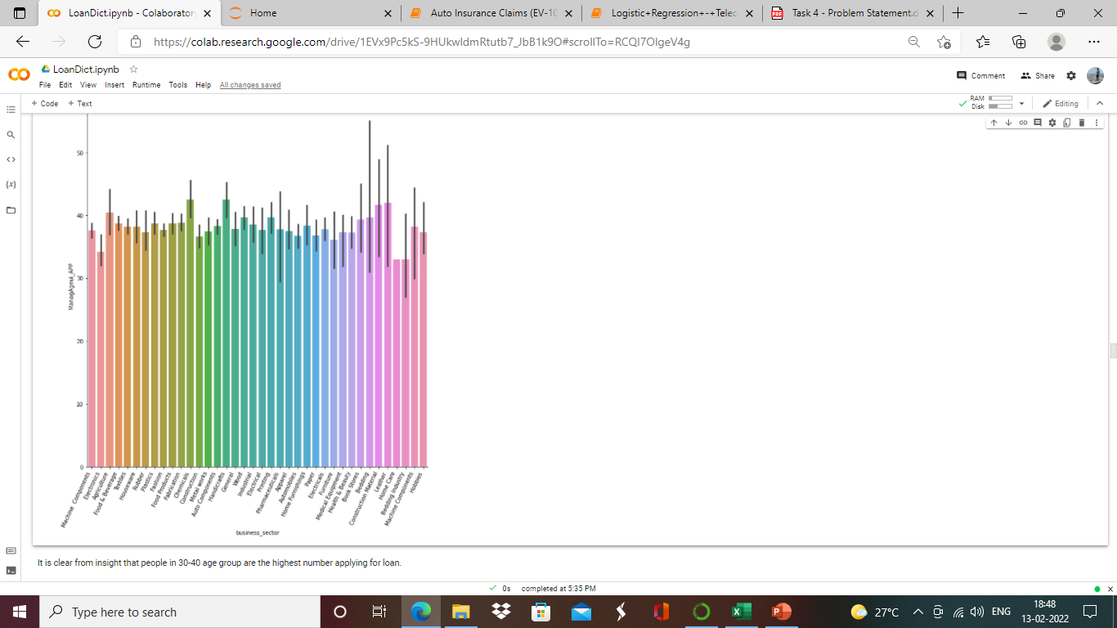

Slide 14
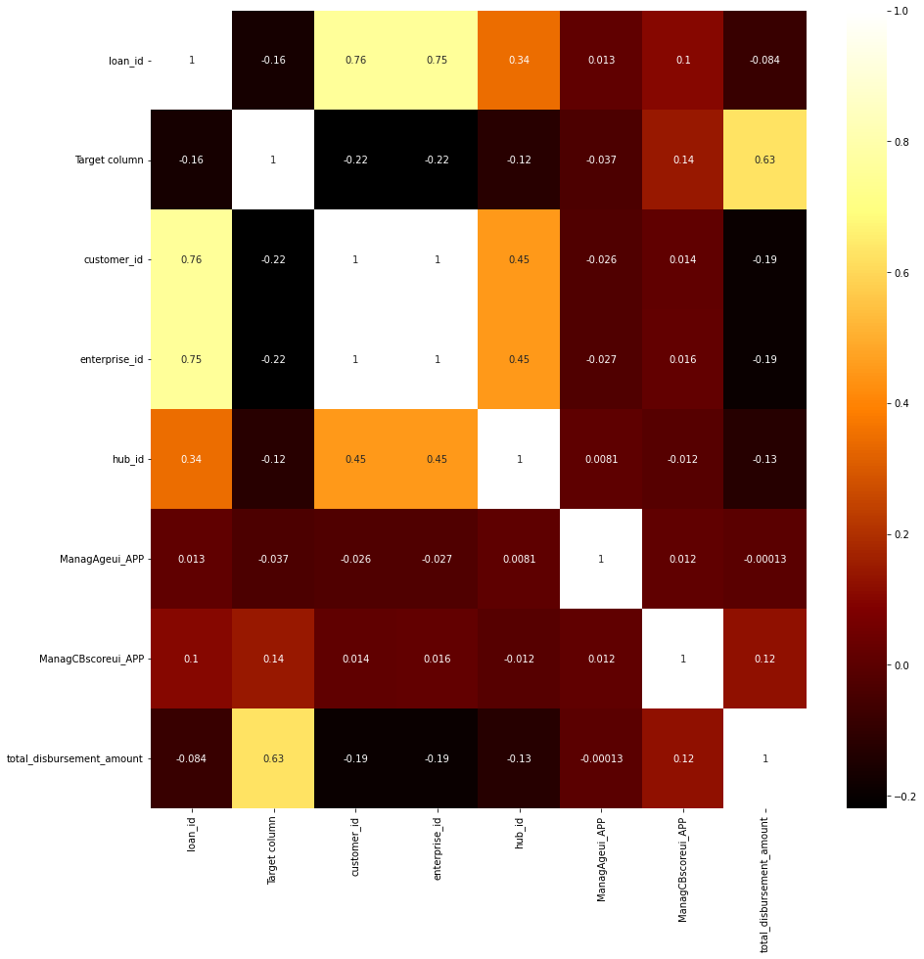
Correlation

Slide 15
We have removed the outliers in the data set with quantile method.
As most of the columns in the dataset were categorized we have used encoding technique to translate the data in one format.
Target column is imbalanced , for which we have used imblearn libraries and with sampling we have tried to balance the imbalanced target column.
Skewness is observed in loan disbursement amount and this is corrected with yeo-johnson.
We have tried using min max sclaer for the independent variable.

Slide 16
Model Building
This task is not completed as refining and more correction is required in the earlier part of the execution of program , or we may require to drop more id columns. We need to run classification algorithms and check the p-value and accuracy after . Sticking to the timeline.
My Github link : AtishGoundadkar (github.com)

Slide 17
Thank YOU

